Slide 1
Programming Fundamentals
Lecture 13

Slide 2
Objectives
C-Strings
Declaration of C-Strings
Initialization of C-strings
Using cin and cout with C-strings
Avoiding buffer overflow
Reading embedded spaces in C-string input
C-String Built-in Functions

Slide 3
Strings
String are special data type in C++, which are used for data which is
Non-Numeric
And More than one character long
For example 12345 is not a string, but 12-345 is a string
This is a logical definition only, if we store 12345 in a string then it will not be a syntax error

Slide 4
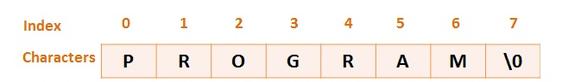
C – Strings
There are two kinds of strings available in C++, C-strings and string objects
We will cover the string objects in details, meanwhile we will just cover the basics of C-strings
C- Strings are 1D array of characters

Slide 5
Declaration of C – Strings
A C-string is declared as an array of characters
For example the following line is indicating that str is a string which can store 30 characters
char str[30];

Slide 6
Initialization of C – Strings
C-string is an array of characters, so can we initialize the c-string like this?
char str[5] = {‘H’,’E’,’L’,’L’,’0’};
The answer is NO
The above statement will be considered as an array of characters but not as a string
The following line will initialize a c-string
char str[6] = “HELLO”;
HELLO contains 5 characters, so why the size of str is 6?
The reason is, every c-string must be terminated by a byte containing 0. This is often represented by a character ‘\0’ and is called Null Character

Slide 7
Initialization of C – Strings
Do we always need to exactly fix the size for each initialization of a C-string?
The answer is No
We can initialize the c-string like an un-sized array
char str[] = “Programming Fundamentals”;
In above statement the size of string is automatically adjusted, but it is only valid for initialization of c-string, while declaring a string we must write the size with it

Slide 8
String Input Methods
For c-strings we can use cin command directly as we did for other data types.
char str[80];
cin>>str;
The above lines will ask the user to enter a string
The problem with above method is that, user cannot enter the string with more than one words
The input will complete as soon as the user presses space bar

Slide 9
Reading Embedded Blanks in C-Strings
If we want to type more than one words as a string then we must use cin.get() or cin.getline() function
char str1[80];
char str2[80];
cin.get(str1, 80); // cin.get(identifier, size)
cin.getline(str2, 80);
Above code will ask the user to enter two string and user will be able to type more than one words

Slide 10
Memory Wastage and Buffer Overflow
char str[60];
cin.get(str,60);
What will happen if user types only 6 characters?
The remaining 53 bytes are wasted
What will happen if the user types more than 60 characters?
All the characters after 59 will be discarded
If we use cin instead of cin.get(), then none of the character will be discarded, but the rest of the data will move in to buffer which may also cause the buffer to overflow
Buffer overflow may cause the program crash or incorrect results

Slide 11
Avoiding Buffer Overflow
We can use the setw() manipulator with stream insertion operator in order to avoid buffer overflow
char str[20];
cin>>setw(20)>>str;
The above code will discard all the character after 20 to avoid buffer overflow

Slide 12
Using cout with C – String
cout statement is used in the same way as we used it for other data types
char str[30];
cin.get(str,30);
cout<<str<<endl;
The above code will ask the user to enter a string and then will display the string

Slide 13
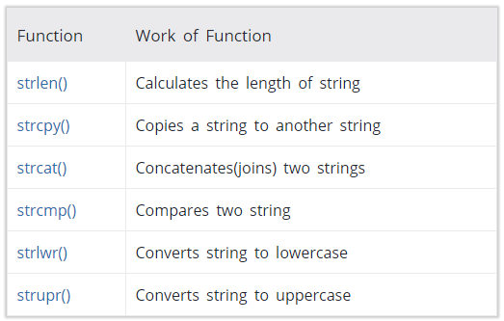
C-String Built-in Functions
There are some built-in string function in cstring header file, some of the functions are

Slide 14
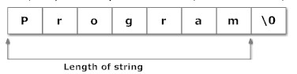
strlen()Function
strlen() fucntion will accept a c-string as an argument and will return an integer
char str[] = “My Name is”;
int l = strlen(str);
cout<<l;
The output will be 10, as null character is not counted as length

Slide 15
strcpy()Function
strcpy() fucntion will accept two c-strings as argument
The sequence of strings in the argument will decide that which string will be moved to other
strcpy(destination string, source string)
char str1[] = “My Name is”;
char str2[] = “XYZ”;
char str3[20];
strcpy(str2,str1);
strcpy(str3,str1);
The above code will assign the value of str1 to str2 and str3

Slide 16
strcat()Function
strcat() function will accept two c-strings as argument and will join them
The sequence of strings in the argument will decide that which string will remain unchanged
strcat(destination string, source string)
char str1[] = “My Name is”;
char str2[] = “XYZ”;
strcat(str1,str2);
The above code will str1 and str2 and result will be stored in str1, while str2 will remain unchanged

Slide 17
strcmp()Function
strcmp() function will accept two c-strings as argument and will return an integer
char str1[] = “My Name is”;
char str2[] = “ABC”;
cout<<strcmp(str1,str2);
The above code will display a positive integer, as the ASCII code of M is greater than A
Return Value | Remarks
0 | Both strings are equal
negative | if the ASCII value of first unmatched character is less than second
positive | if the ASCII value of first unmatched character is greater than second

Slide 18
strlwr()Function
strlwr() function will accept a c-string as an argument and will convert its all the characters to lower case
char str1[] = “MY NAME IS”;
strlwr(str1);
cout<<str1;
The above code will display “my name is” as all the characters of str1 are converted to lower case

Slide 19
strupr()Function
strupr() function will accept a c-string as an argument and will convert its all the characters to upper case
char str1[] = “My Name is”;
strupr(str1);
cout<<str1;
The above code will display “MY NAME IS” as all the characters of str1 are converted to upper case

Slide 20
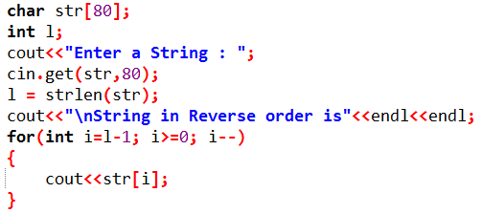
Practice Problem 1
Write a C++ program which should ask the user to enter a c-string and then display the string in reverse order

Slide 21
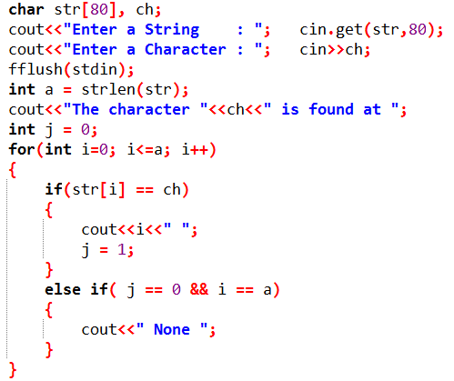
Practice Problem 2
Write a C++ program which should ask the user to enter a c-string and a character, then search the character in the string and display all the positions, on which the character is found

Slide 22
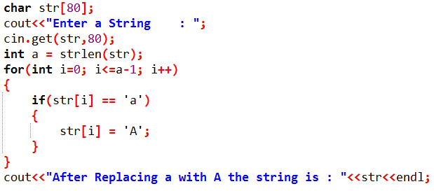
Practice Problem 3
Write a C++ program which should ask the user to enter a c-string and then replace all the lower case letters “a” with upper case “A”

